Slide 1

Occupational Science Europe Network
Welcome to the Launch Meeting!

Slide 2
Agenda:
Orientation
Care taking to date
Aims & role
Future
Sign up
Any other ideas

Slide 3


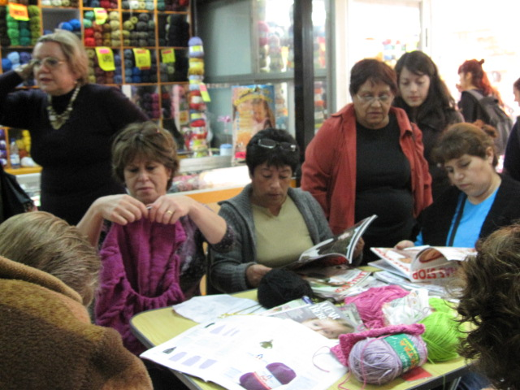
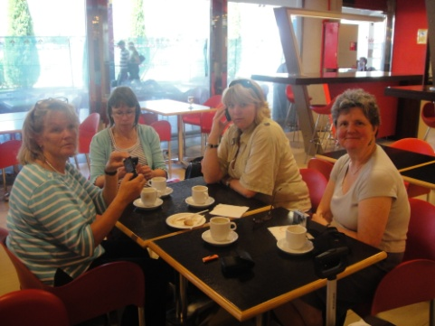

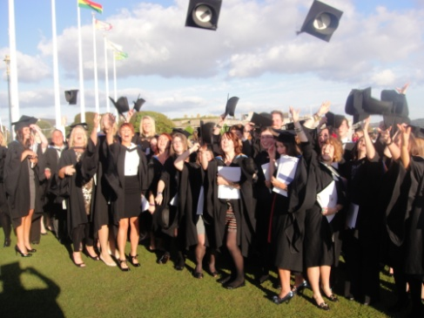
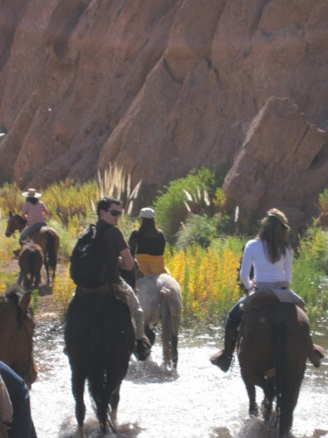
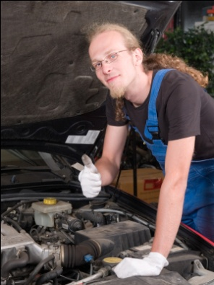
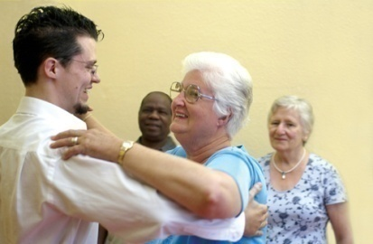
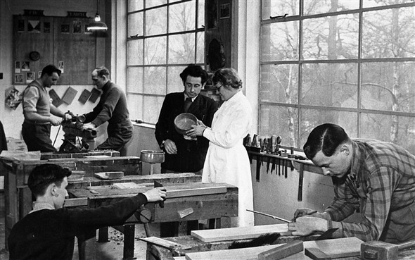

International Conference
8th – 9th September 2011

Slide 4

Caretaking to date
Post Owning Occupation Conference Committee Working Group
– UK & Ireland & now wider?
Post Owning Occupation Conference Network members
– UK & Ireland & now wider?

Slide 5
Aims & role of OSE
Post Owning Occupation Conference Committee Working Group
– UK & Ireland & now wider?
Gaynor Sadlo, Shaan Ellor, Susan Corr, Eithne Hunt, Jeanne Jackson, Kirsty Stanley, Anne Roberts, Bethan Collins, Jane Cronin-Davis, Teena Clouston, Carol Mytton, Lyn Westcott, Jackie Taylor, Elaine Ballantyne
Post Owning Occupation Conference Network members
– UK & Ireland & now wider?

Slide 6

Occupational Science Europe Network Aims
  "The aim of this group is to support the development
  of occupational science throughout Europe.
  We aim to generate understanding about humans as occupational beings
  & to explore the relationship between occupation & health.
  It will be a multidisciplinary group & we will actively encourage
  involvement of many disciplines (such as anthropology, human geography
  & sociology), to understand occupation from its many perspectives.
  We also seek further understanding of the therapeutic potential
  of occupation, to underpin occupational therapy practice.
  We aim to provide a freely available on-line resource for sharing news,
  information, links to other sites and discussion.
  We also aim to hold an occupational science conference
  every two years, responsibility & venue to be shared".

Slide 7
OSE Role
Network: practitioners – students - academics
Exchange ideas & experiences
Debate issues
Share resources
Collaborate in research
Develop the knowledge base
Keep in touch with colleagues who have an active interest in occupational science
Anything else??

Slide 8

Future 1:
Nominations for committee
(rolling terms of office 3 years)
  Chair & vice chair
  Secretary & vice
  Conference officer & vice
  Website officer
  Treasurer
  Working officers
Conference & other learning events
  Key conference every 2 years

Slide 9
Future 2:
Links with other networks
  OSE PhD Researchers’ Group
    Via LinkedIn
  ISOS / ECOTROS?
  Anything else?

Slide 10


IT Links
Website is now live at: http://occupationalscienceeurope.wordpress.com/
Facebook page: http://www.facebook.com/OSEurope
Twitter account:
https://twitter.com/#!/OSEurope

Slide 11

Sign up:
Nominations for committee
  if you would like a post on the committee
  OR
  if you would like to join the network as a member
  LEAVE US YOUR CONTACT DETAILS
  & WE WILL E:MAIL YOU

Slide 12

Any other ideas?:
Anne.Roberts@plymouth.ac.uk
Lyn.Westcott@plymouth.ac.uk

